Slide 1


SneakR
Team members:
Tóth Krisztián
Kenéz Bence
Kreszl Tamás

Slide 2
The Problem
Limited Options
- Existing sneaker stores often lack variety and offer a limited selection of brands and styles.
High fees
- Some online retailers have really high fees for selling used sneakers.
Few platforms
- There are few platforms that are easy for resellers to use and where used shoes can be sold easily.

Slide 3

SneakR’s solution
1
Comprehensive Selection
2
Low fees
Our platform offers a wide range of popular brands, ensuring customers find their perfect match.
We offer low fees, because we are making profit from advertisments.
3
Our platform
We are the only platform where you can buy and sell shoes either from a another reseller, or from our website.

Slide 4
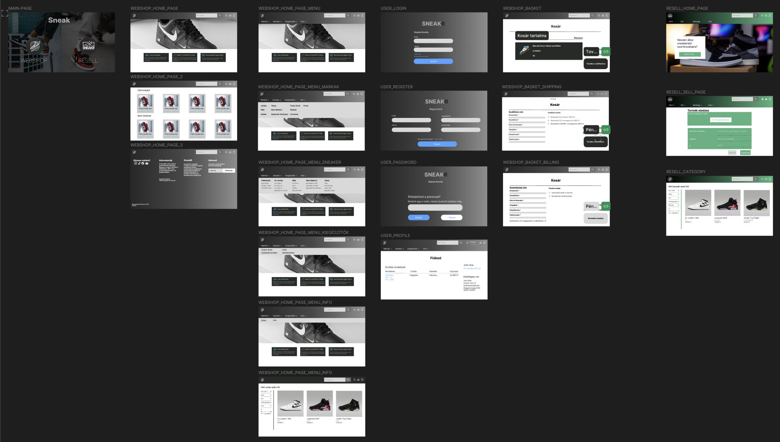
Design plan

Slide 5
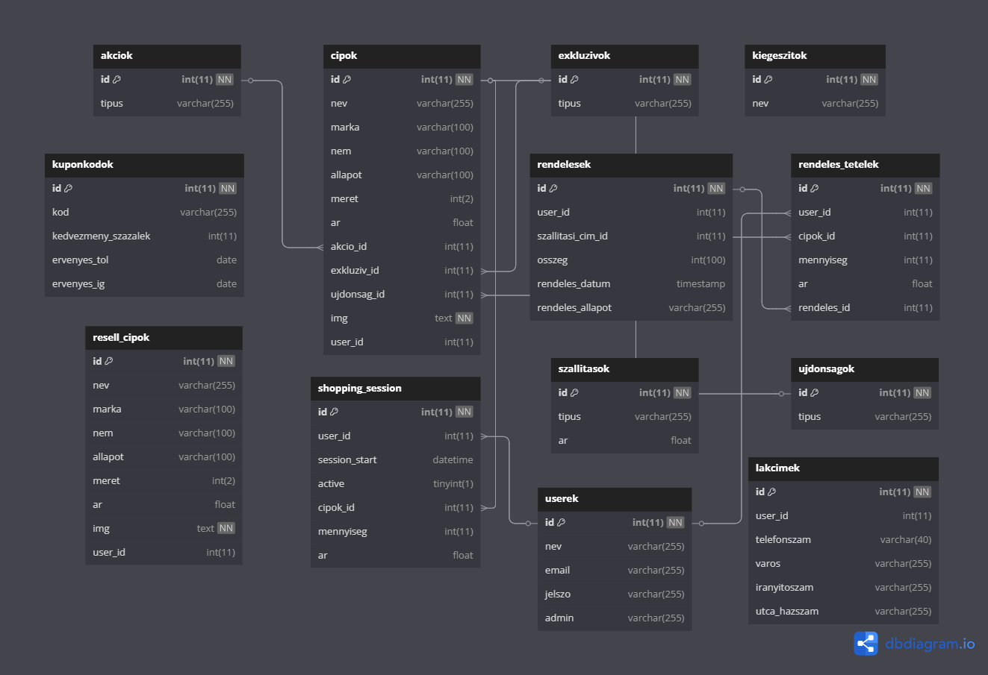
Database plan

Slide 6
Architectures used in our project
Frontend (Angular, Typescript)
Backend (Java)
Database (MySQL)
The user interface is built with Angular, a popular framework for creating dynamic and responsive web applications.
The server-side logic is implemented using NodeJS, a robust and scalable runtime environment for JavaScript.
We chose MySQL as our database, a NoSQL solution that provides flexibility and scalability for storing data about products, customers, and orders.

Slide 7
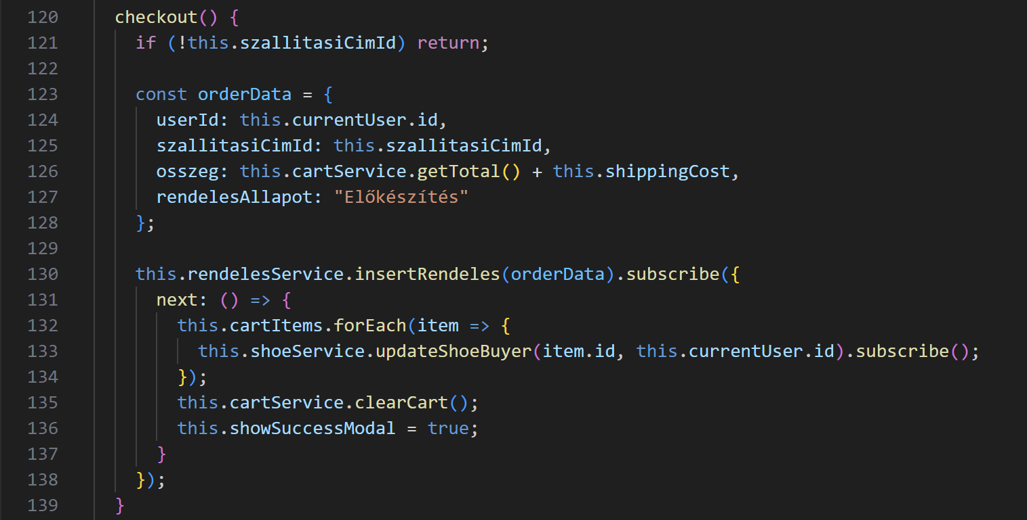
Frontend (Angular, Typescript)

Slide 8
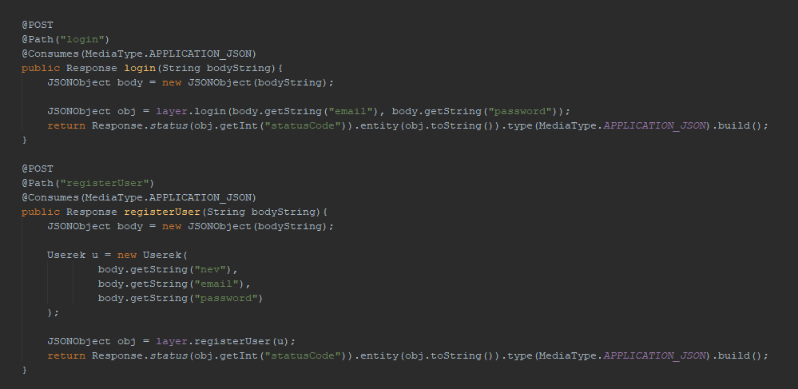
Backend (Java)
API request for login and register

Slide 9
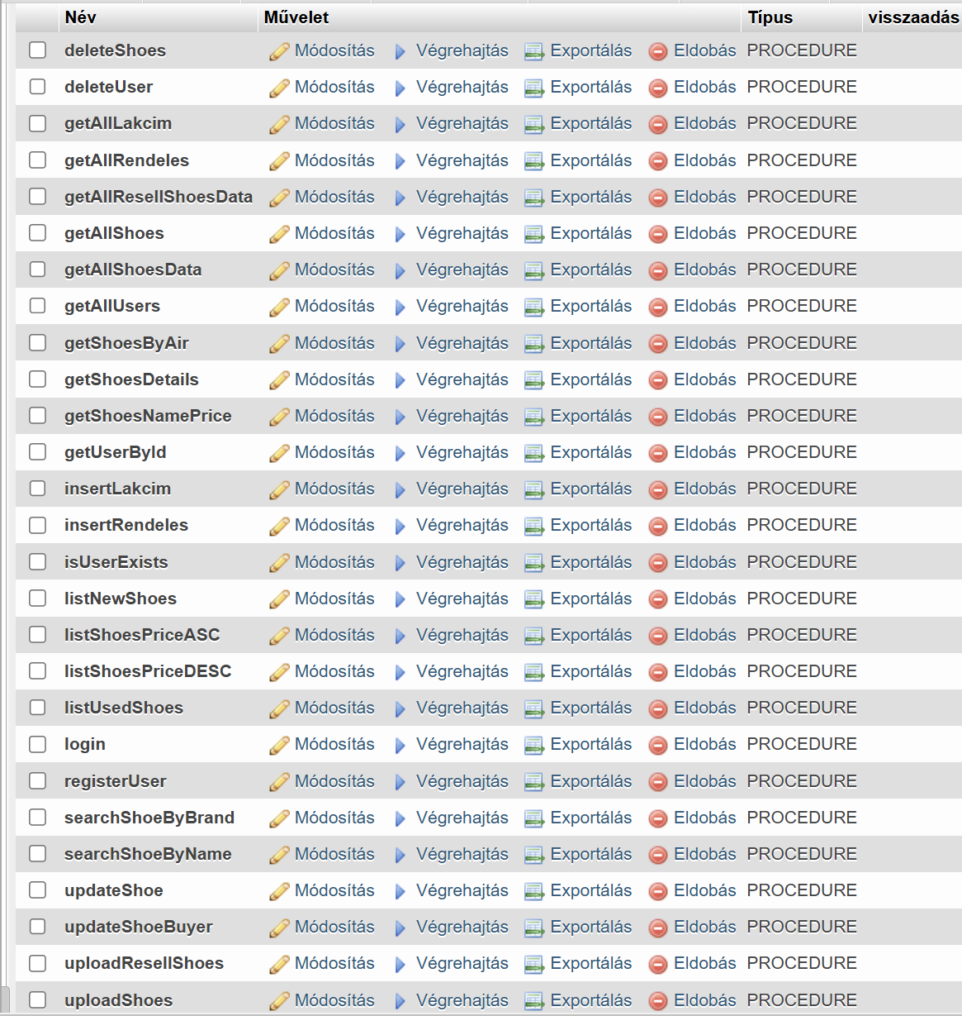
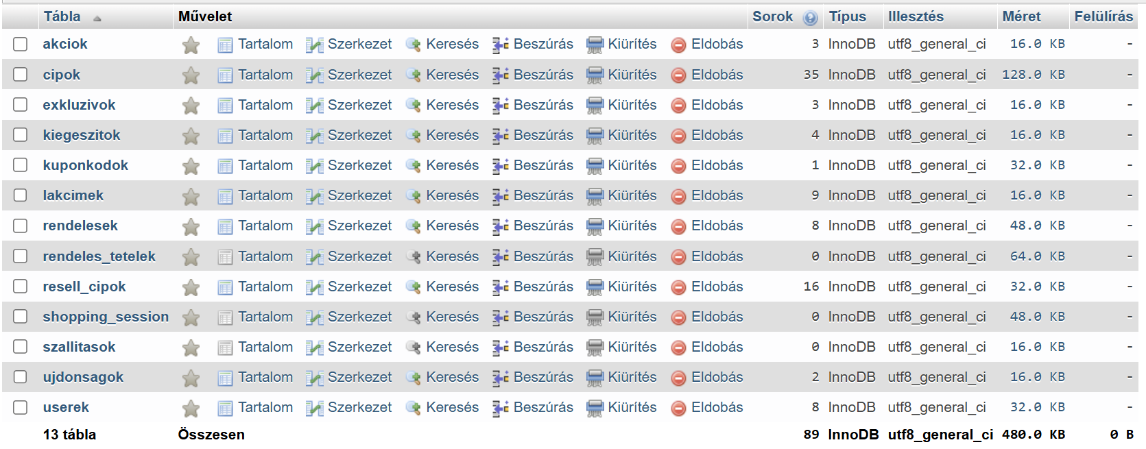
Database (MySQL)
Database Routines
Database Structure

Slide 10

Teamwork and Project Management
1
Git
We used Git for version control, allowing us to track changes, collaborate effectively, and manage code branches.
2
Jira
Jira served as our project management tool, enabling us to track tasks, assign roles, and monitor progress.
3
Communication
We established clear communication channels, including regular meetings and online discussions on Discord, to ensure smooth collaboration and effective problem-solving.

Slide 11
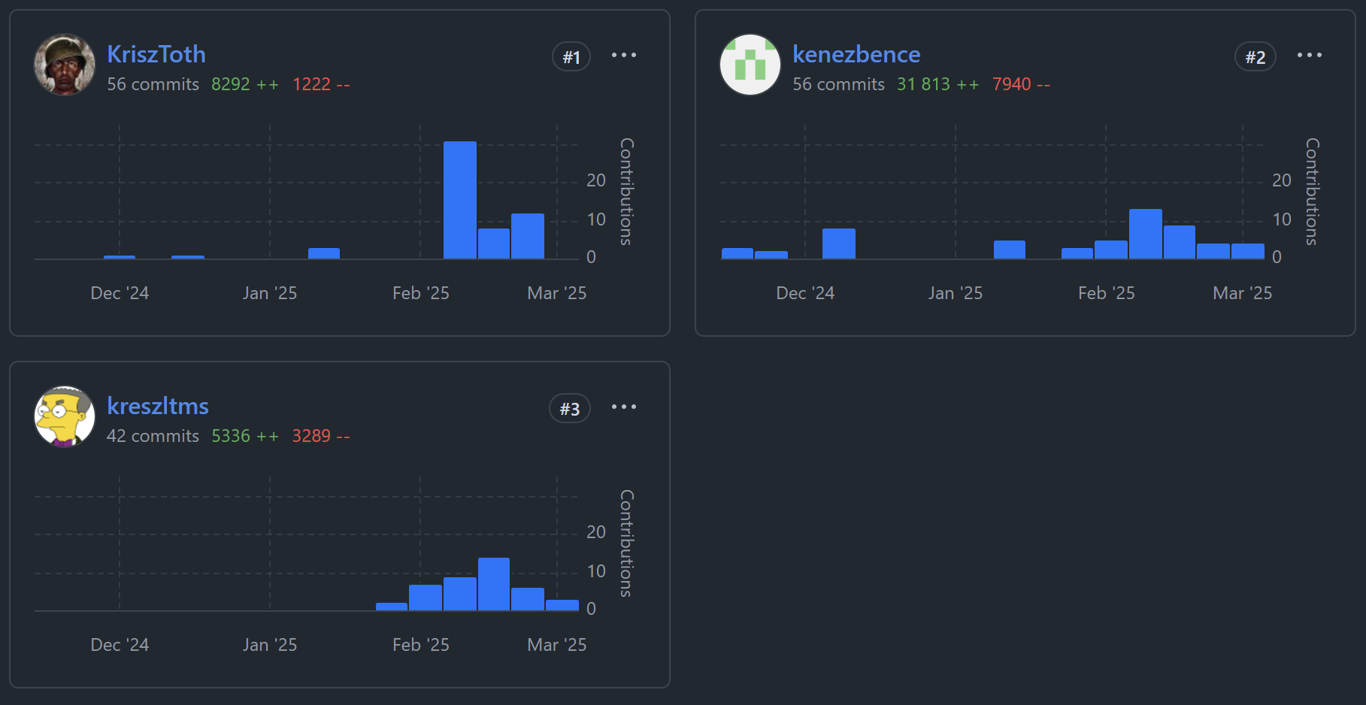
Teamwork and Project Management
Github commit distribution

Slide 12
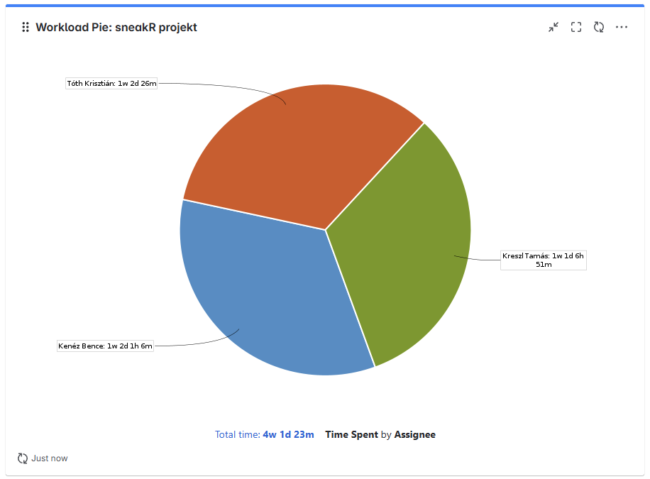
Teamwork and Project Management
Jira Workload

Slide 13



Testing
Unit testing: We conducted thorough unit tests to ensure individual components of the code function correctly.
Integration testing: We tested how different modules interact with each other to ensure seamless integration.
User acceptance testing: We involved real users to test the website's usability, functionality, and overall user experience.

Slide 14
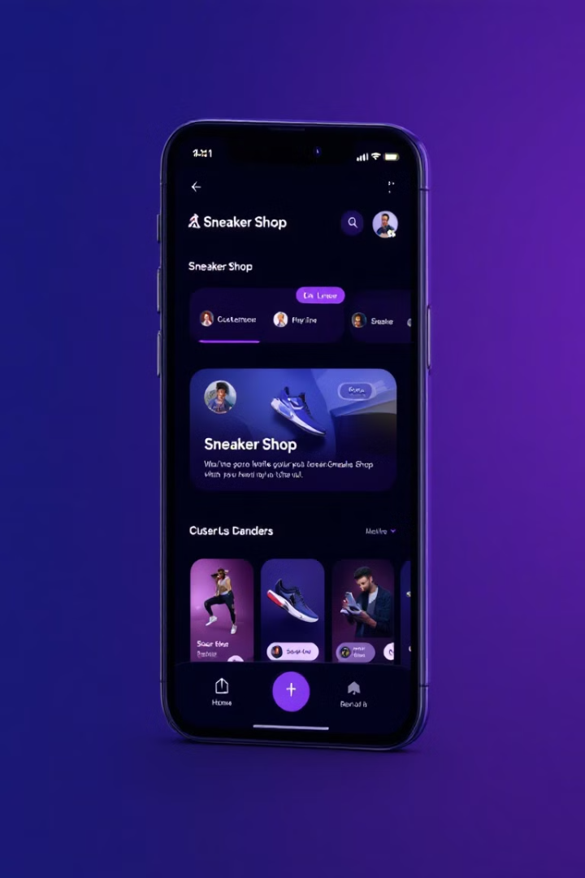
Next Steps
Integrating SimplePay
We plan to integrate SimplePay secure payment system.
Mobile application development
We will start developing the Mobile application.
Feedback
We will continuously gather feedback from users and make adjustments to improve the platform's functionality and user experience.

Slide 15
Thank you for watching our presentation! Now let's move on to the live demonstration of our application!

